Slide 1
Introduction to databases
INT 306
By- Hargobind SIngh

Slide 3

What is Data ?
Data vs
Information

Slide 4
Data
5
name
height
Data: It can be anything like name, place or number, etc. Data usually refers to raw data, or unprocessed data.
age
Virat
4
years
feet

Slide 5
INFORMATION
Information: It is organized or classified data so that it has some meaningful values to the receiver.
Information is the processed data on which decisions and actions are based.

Slide 6
Example
5
name
name
Virat
height
age
age
5
years
Virat
4
feet
height
4
feet
years
process

Slide 7
Data vs information
Raw facts and figures
12
Atomic level pieces
No help in decision making
Processed form of data
Age 12
Collection of data
Helps in decision making

Slide 8
Databases
A database is a shared collection of logically related data designed to meet the information needs of an organization
The related information when placed is an organized form makes a database.
The organization of data/information is necessary because unorganized information has no meaning.

Slide 9
Database Management System
DBMS A database management system is the software system that allows users to define, create and maintain a database and provides controlled access to the data.
OR
A database management system (DBMS) is basically a collection of programs that enables users to store, modify, and extract information from a database as per the requirements.

Slide 10
Examples of dbms
SQL server
ORACLE 9i,10g,11,12c..
MY SQL (Microsoft SQL)
DB2 (IBM)
Microsoft Access

Slide 11
Operations on databases
To add new information
To view or retrieve the stored information
To modify or edit the existing
To remove or delete the unwanted information
Arranging the information in a desired order etc.

Slide 12
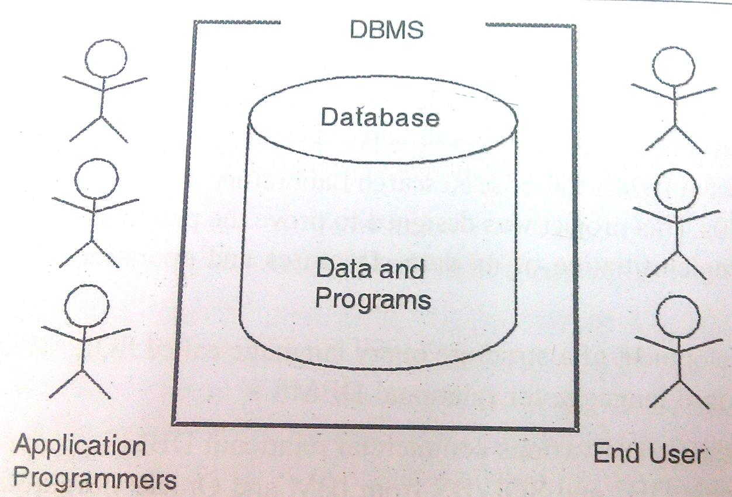
Components of Database System
Five major components in database
system environment:
Hardware
Software
Data
Users
Procedures

Slide 13
Components of Database System
Hardware: It is the actual computer system used for keeping and accessing the database. DBMS hardware consists of secondary storage devices like hard disks.
Software: It is the actual DBMS. Between the physical database itself and the users of system is a layer of software, called DBMS.
Data: Data acts as the bridge between the machine components and user components.

Slide 14
Types of data
Structured data
Unstructured data
Semi Structured data

Slide 15
Structured data
Structured data is the data which conforms to a data model, has a well define structure, follows a consistent order and can be easily accessed and used by a person or a computer program.
Structured data is usually stored in well-defined schemas such as Databases. It is generally tabular with column and rows that clearly define its attributes.
SQL (Structured Query language) is often used to manage structured data stored in databases.

Slide 16
Unstructured data
Unstructured data is the data which does not conforms to a data model and has no easily identifiable structure such that it can not be used by a computer program easily. Unstructured data is not organized in a pre-defined manner or does not have a pre-defined data model, thus it is not a good fit for a mainstream relational database
Sources of Unstructured Data:
Web pages
Images (JPEG, GIF, PNG, etc.)
Videos
Memos
Reports
Word documents and PowerPoint presentations
Surveys
.

Slide 17
SEMI-STRUCTURED DATA
Semi-structured data is the data which does not conforms to a data model but has some structure. It lacks a fixed or rigid schema. It is the data that does not reside in a rational database but that have some organizational properties that make it easier to analyze. With some process, we can store them in the relational database.
Sources of semi-structured Data:
E-mails
XML and other markup languages
Binary executables
TCP/IP packets
Zipped files
Integration of data from different sources

Slide 18
Components of Database System
Users: There are number of users who can access or retrieve data on demand using the applications and the interfaces provided by DBMS. The users can be:
Data base Administrator ( DBA)
Database Designer
Application Programmers
End Users: These are divided into:
Casual End User
Naïve End User
Sophisticated End User

Slide 19
Data base Administrator ( DBA)
Database Administrator (DBA) is a person/team who defines the schema and also controls the 3 levels of database. The DBA will then create a new account id and password for the user if he/she need to access the data base. DBA is also responsible for providing security to the data base and he allows only the authorized users to access/modify the database. DBA also monitors the recovery and back up and provide technical support.
The DBA has a DBA account in the DBMS which called a system or superuser account.
DBA repairs damage caused due to hardware and/or software failures.

Slide 20
Database Designer
Data Base Designers are the users who design the structure of data base which includes tables, indexes, views, constraints, triggers, stored procedures. He/she controls what data must be stored and how the data items to be related.
Application Programmers
Application Program are the back end programmers who writes the code for the application programs. They are the computer professionals. These programs could be written in Programming languages such as Visual Basic, Developer, C, FORTRAN, COBOL etc.

Slide 21
Casual End User
These Users occasionally access the database but may need different information each time. They use sophisticated database Query language to specify their requests. For example: High level Managers who access the data weekly or biweekly.

Slide 22
Naïve / parametric End User
Any user who does not have any knowledge about database can be in this category. There task is to just use the developed application and get the desired results.
For example: Clerical staff in any bank is a naïve user. They don’t have any dbms knowledge but they still use the database and perform their given task.

Slide 23
Sophisticated END users
Sophisticated users can be engineers, scientists, business analyst, who are familiar with the database. They can develop their own data base applications according to their requirement. They don’t write the program code but they interact the data base by writing SQL queries directly through the query processor.

Slide 24
Components of Database System
Procedures: It refers to the instructions and rules that govern the design and the use of the database. The users of the system and the staff that manage the database requires documented procedures on how to use or run the system.

